Slide 1
Bible Reading
Kathryn Mauger

Slide 2
Exodus 4:10-10
10 Moses said to the Lord, “Pardon your servant, Lord. I have never been eloquent, neither in the past nor since you have spoken to your servant. I am slow of speech and tongue.” 11 The Lord said to him, “Who gave human beings their mouths? Who makes them deaf or mute? Who gives them sight or makes them blind? Is it not I, the Lord?
New International Version

Slide 3
Exodus 4:10-10
12 Now go; I will help you speak and will teach you what to say.” 13 But Moses said, “Pardon your servant, Lord. Please send someone else.” 14 Then the Lord’s anger burned against Moses and he said, “What about your brother, Aaron the Levite? I know he can speak well. He is already on his way to meet you, and he will be glad to see you.
New International Version

Slide 4
Exodus 4:10-10
15 You shall speak to him and put words in his mouth; I will help both of you speak and will teach you what to do. 16 He will speak to the people for you, and it will be as if he were your mouth and as if you were God to him. 17 But take this staff in your hand so you can perform the signs with it.”
New International Version

Slide 5
Exodus 4:10-10
18 Then Moses went back to Jethro his father-in-law and said to him, “Let me return to my own people in Egypt to see if any of them are still alive.” Jethro said, “Go, and I wish you well.” 19 Now the Lord had said to Moses in Midian, “Go back to Egypt, for all those who wanted to kill you are dead.” 20 So Moses took his wife and sons, put them on a donkey and started back to Egypt. And he took the staff of God in his hand.
New International Version

Slide 6
MOSES
Called by GOD – Hears, Hesitates and Responds
Exodus 3:1 - 4:20

Slide 7
The Decision to Follow God
Hearing the call of God, how do we respond?
Moses’ initial responses
Doubt
Afraid
Fearing rejection
Feeling inadequate
How does God deal with our excuses?

Slide 8
Israel’s Need – God’s Concern
After fleeing the royal household, Moses worked for forty years as a Shepherd
Then a meeting with God
Flaming bush in the middle of a desert
God’s presence
God responds to the needs of the people
He would rescue them
But how?
By sending Moses!!

Slide 9
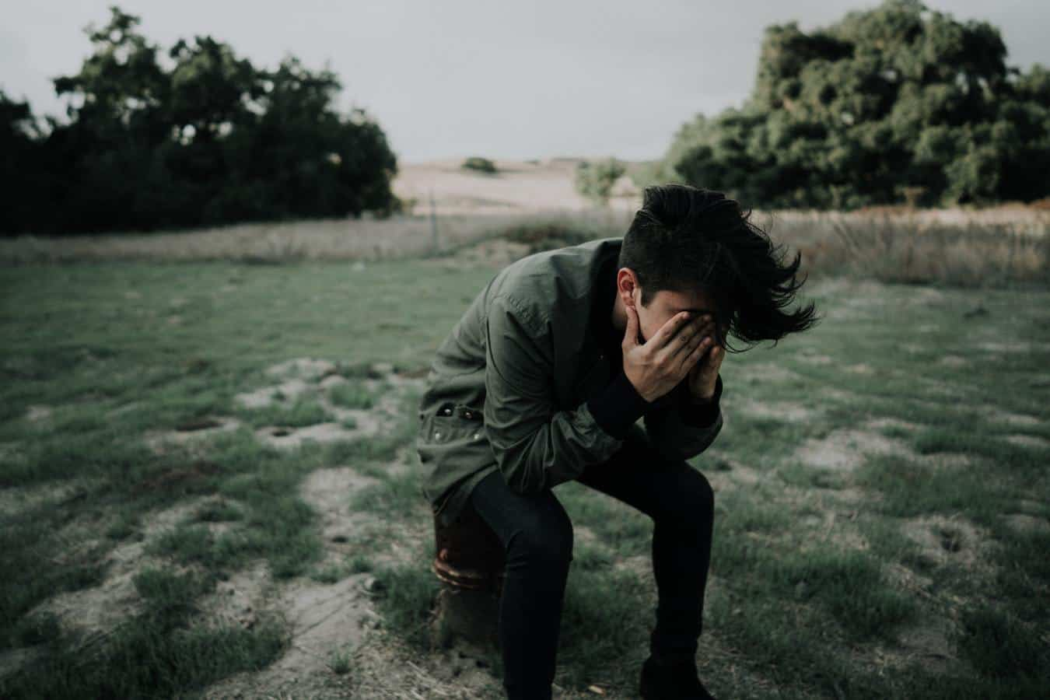
Moses’ first Response: Self Doubt
Being a shepherd hardly gave Moses the right training
God’s response:
“I will be with you”
Moses might have been a nobody, but the creator of the world would be with him
Doubts continue – what name?
God’s response:
“I am”
Implies eternal existence
Relevant to the present
Singular

Slide 10
Moses’ second Response: Fear of Failure
Afraid of rejection and failure
What if they don’t believe me or listen to me? How am I going to prove it?
God’s response:
To Moses an actual demonstration of Power
Staff becomes a snake
Hand becomes leprous
Water becomes blood
For us real power is given through the Gospel
Power that changes lives
Power that brings people back to God.

Slide 11
Moses’ third Response: Sense of Inadequacy
But I’m no good at speaking
What if I don’t say the right thing?
God’s response:
God would do the convincing
God would give the words to say.
God would give support by giving Moses the help of Aaron, Moses’ brother.
Help and encouragement of fellow believers.

Slide 12
Israel’s Need – God’s Imperative
No more excuses and Moses is commanded to go.
An amazing transformation occurs
Hesitant Moses becomes assured leader
Moses himself does much of the speaking

Slide 13
Challenge for us today
God does not ask us to do things we cannot do
Trust that God will help
Learn to rely on the power of the Gospel
Trust God to be with you
Trust God for the words you need.
Look to fellow believers for support and encouragement.

